Slide 1

Every church. Every community.

Slide 2

ServeNC is an opportunity for every N.C. Baptist church to love its community in Jesus’ name through service projects.

Slide 3

EVERY CHURCH
EVERY COMMUNITY

Slide 4
MOBILIZE • UNIFY • CATALYZE

Slide 5
AUGUST 3-10, 2024

Slide 6
WHAT
PRAY
Prayer is our primary strategy.
CAN
PLAN
YOU DO?
How will you be involved?
PROMOTE
You have the best
opportunity for enlisting participation!

Slide 7
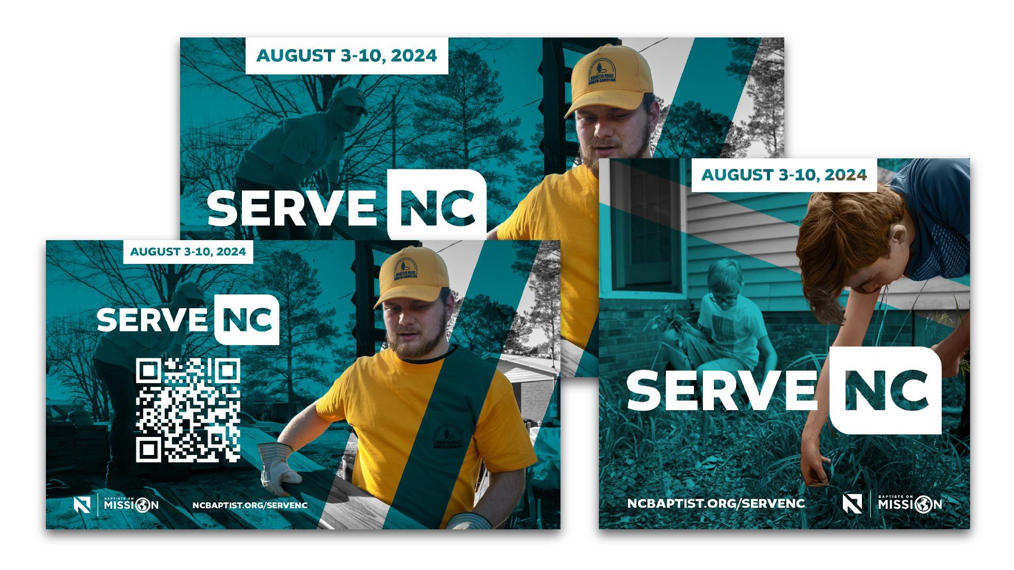
PROMO
RESOURCES
SERVENC.COM

Slide 8

CHURCH KIT
ServeNC.com

Slide 9
@ncbaptist
FOLLOW
@baptistsonmission
#ServeNC
_{WEBSITE} ServeNC.com
EMAIL US
ServeNC@ncbaptist.org

Slide 10
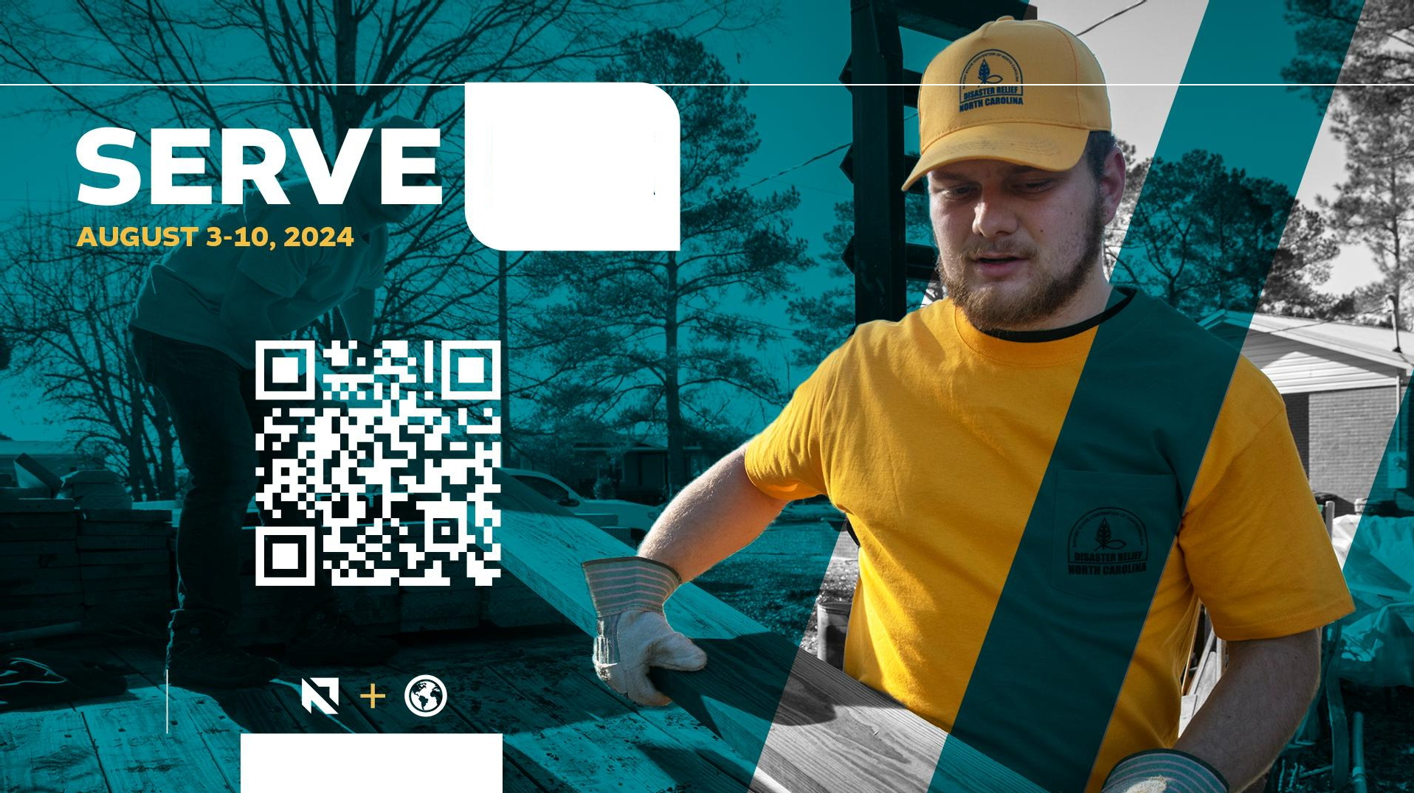
NC
SERVENC.COM

